Slide 1
Adversarial example and Fast Gradient Sign Method
Kim Seung Hwan (overnap@khu.ac.kr)

Slide 2
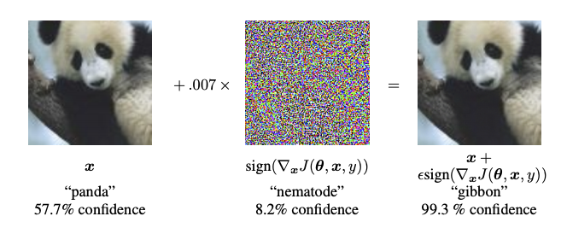
What is an Adversarial examples?

Slide 3
What is an Adversarial examples?
An image with appropriate perturbation to misclassify
Using these to fool the model is called an Adversarial attack

Slide 4
What is an Adversarial examples?
One of the important properties of the examples is that the perturbation should NOT be identified by humans
So this is also how to make difficult samples
i.e., It can be viewed as a kind of argumentation

Slide 5
Why are the examples important?
DL models are close to our lives
Maliciously confusing commercial models is likely

Slide 6
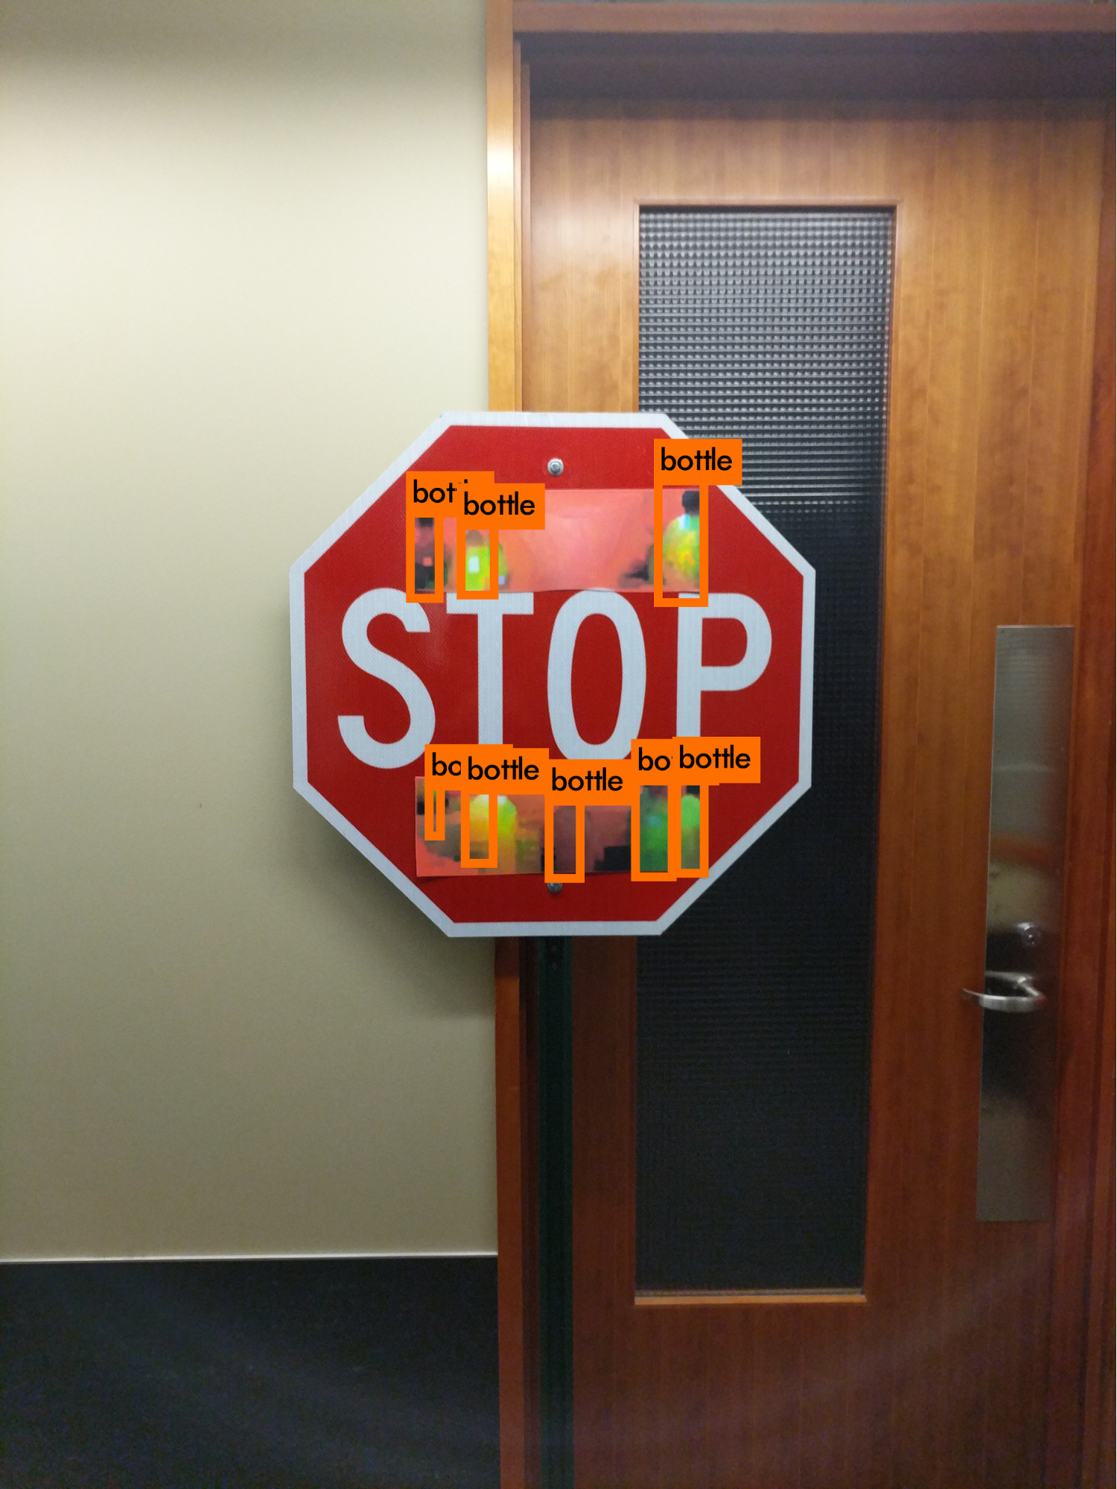
Why are the examples important?
Defending the examples increase the robustness of a model
This is especially important in areas where misclassification can lead to serious problem (e.g. self-driving)

Slide 7
Types of Adversarial attacks
The attacks can be classified into two categories:
1. Knowledge level
2. Goal level

Slide 8
Types of Adversarial attacks
How much the attacker knows about the model
How complex the goal the attacker wants

Slide 9
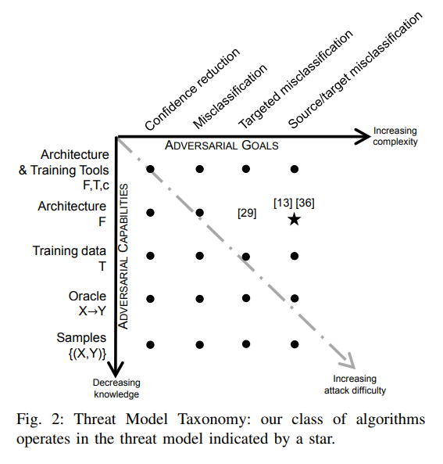
Types of Adversarial attacks

Slide 10
Types of Adversarial attacks
Consider a model that checks if a profile image is a photo of a person
An attacker wants to post a very offensive picture

Slide 11
Types of Adversarial attacks
The attacker can only get the class inferred
Also wants his picture to be classified as a photo of a person

Slide 12
Types of Adversarial attacks
In terms of knowledge, Oracle; i.e., X->Y where Y is a class
In terms of the goal, Source/Target Misclassification

Slide 13
Fast Gradient Sign Method
Today I present to FGSM
FGSM is a way to make perturbations that cause (untargeted) misclassification when you know everything about model

Slide 14
Fast Gradient Sign Method
Creating adversarial examples is very easy if you know the architecture of the model, i.e. both topology and weights
It is mainly obtained through differentiation
Differentiate weights of the model or the loss

Slide 15
Fast Gradient Sign Method
FGSM is a method of differentiating the loss
It uses the gradient to move the loss increase

Slide 16
Fast Gradient Sign Method
It is very intuitive to propagate the gradient of the loss to the input to make adversarial examples
Let us go into more detail

Slide 17
Fast Gradient Sign Method
Introduced at ICLR 2015
“Explaining and Harnessing Adversarial Examples” (Goodfellow et al.)

Slide 18
Fast Gradient Sign Method
Although nonlinearity is an important characteristic of DL, many models are designed to be close to linear (e.g. ReLU)
This is because the linear behaviour is easy to analyze and learns well

Slide 19
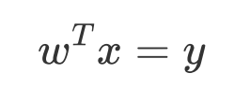
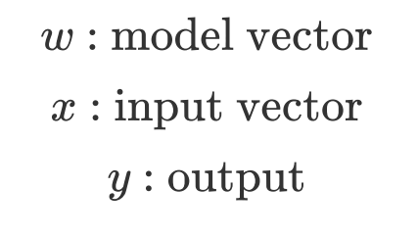
Fast Gradient Sign Method
Consider a linear model
All model w/o nonlinear effects can be express as linear combinations of input features as:

Slide 20
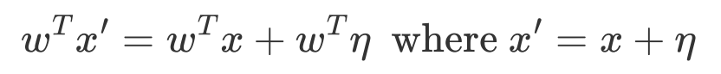
Fast Gradient Sign Method
So for the perturbated input:

Slide 21
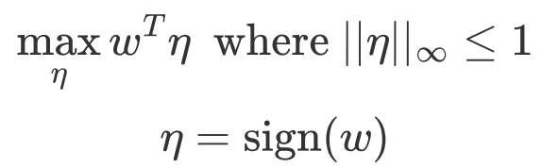
Fast Gradient Sign Method
Maximize the impact of the perturbation
Subject to the max norm constraint

Slide 22
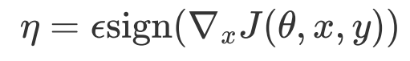
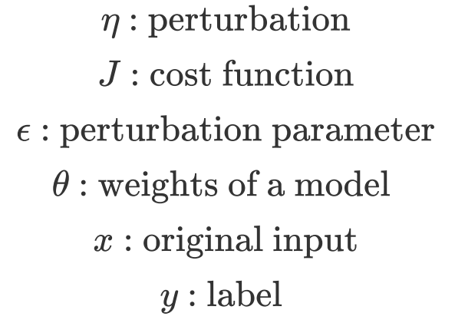
Fast Gradient Sign Method
Assume that the cost function is linear around the current theta
The perturbation can be optimized in the same way in nonlinear model

Slide 23
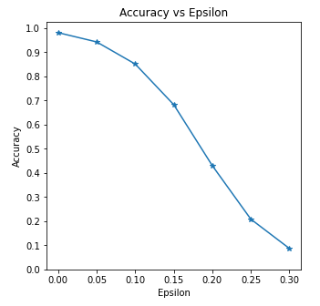
Experiments 1
FGSM applied with pretrained LeNet and MNIST

Slide 24
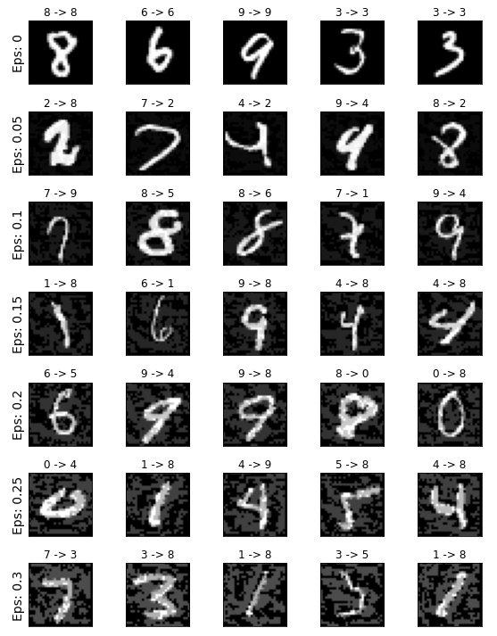
Experiments 1

Slide 25
Experiments 1
It works well, but to reduce accuracy by more than half, you have to increase the epsilon very much
In this case, humans perceive perturbation
I think this is because MNIST only has brightness channel, and humans are sensitive to brightness

Slide 26
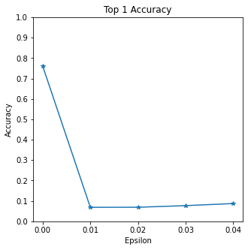
Experiments 2
FGSM applied with pretrained ResNet50 and ImageNet 2012 valid set
A very mild perturbation is sufficient

Slide 27
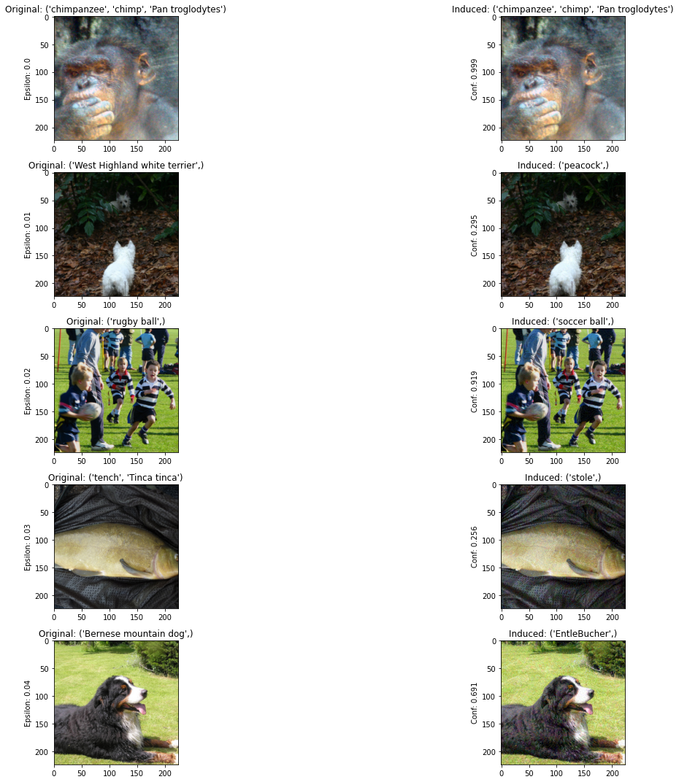
Experiments 2

Slide 28
Experiments 2

Slide 29
Experiments 2
Since the dimension is very large compared to MNIST, even small epsilon is effective
Therefore it is difficult for humans to recognize perturbation

Slide 30
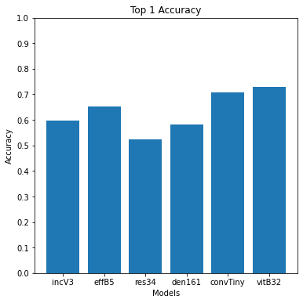
Experiments 3
The property of adversarial examples that can be used in one model for another is called Adversarial Transferability
Use 10% subset of ImageNet 2012 valid set perturbated in pretrained ResNet50

Slide 31
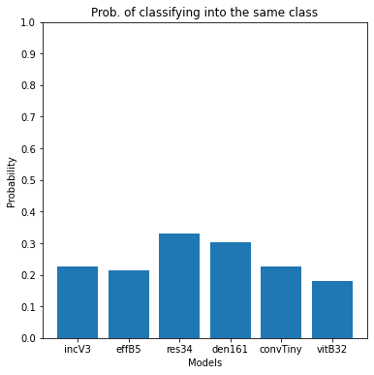
Experiments 3
Significant accuracy reduction considering that most models exceed 80% for clean inputs
However, both scores showed performance below than the paper

Slide 32
Discussion 1
This is very similar to gradient descent method
But instead of updating weights of the model in the downward direction, it updates the input in the rising direction

Slide 33
Discussion 1
The way to make adversarial examples must be very fast to be practical; because you must perturbate and train a bunch of samples
FGSM is very good in the above aspect
Using backpropagation, you can easily get the gradient, and the sign function is very computationally efficient

Slide 34
Discussion 2
Why max norm?
Max norm does not grow with the dimensionality of the problem; but the impact of the perturbation does
Euclidean norm, on the other hand, does
In the photo of Exp. 2, the perturbation, as large as epsilon * dimensionality by Euclidean distance, is not perceived

Slide 35
Discussion 3
The authors argue that nonlinear models are better at defending adversarial examples, since the examples generated by FGSM do not work well in RBFN
But FGSM is a method based on linearity
There was also a significant decrease in accuracy (but less compared to more linear-like networks) in RBFN

Slide 36
Discussion 4
Consider a sufficiently low-dimensional and simple problem
Making adversarial examples is transforming original samples into points located on the vague part of the decision boundary
But common problems have many classes and are very high-dimensional
How can it be intuitively understood?
Can adversarial transferability be explained in this regard?

Slide 37
Conclusion
Understanding adversarial examples, especially focusing on linearity of models
A simple and fast adversarial attack method for untargeted misclassification, FGSM proposal
i.e., Proposal of a practical adversarial defence method

Slide 38
Further study
Clear understanding adversarial examples through the space of data, models and decision boundaries
What it means to not be perceived by humans and how to measure it
Different types of adversarial attack & defence methods (e.g. black-box targeted attack)

Slide 39
Thanks
Kim Seung Hwan (overnap@khu.ac.kr)

